Slide 1


UCF439 Capstone Project Medical Examiner Group No 155
Supervisor’s name : Sanjay Kumar
Supervisor’s Email: sanjay.kumar@dituniversity.edu.in
Student’s name: Deepak
SAP IDs: 1000014934
Student’s name: Nilay Singh
SAP IDs : 100001490

Slide 2
Introduction
Our project introduces an innovative approach to disease detection: analyzing medical prescriptions. By uncovering valuable insights from prescription data, we're developing an advanced model for early disease identification.
Our innovative approach analyzes prescription data to swiftly identify diseases, benefiting both doctors and patients. By providing personalized insights, we simplify disease understanding, leading to quicker diagnoses and improved outcomes for all involved.

Slide 3
References/Related work/comparison
Previous Research and Projects
Title: "Predicting Disease Risks from Highly Imbalanced Data Using Random Forest" Authors: Jin Zhu, Ehsan Adeli, Suhong Jin
Abstract: This paper presents a method for predicting disease risks using electronic health records (EHRs), which include doctor prescriptions among other data. The authors utilize random forest classifiers and address the challenge of imbalanced data to improve prediction performance.
Title: "Predicting Health Status from Electronic Health Records: A Deep Learning Approach" Authors: Harini Suresh, Sydney E. Li, Wei Zhang
Abstract: In this paper, the authors propose a deep learning approach to predict patient health status from electronic health records, including doctor prescriptions. They use recurrent neural networks (RNNs) and convolutional neural networks (CNNs) to model sequential patient data and achieve promising results.

Slide 4



Feasibility study
Financially Feasible
Socially Feasible
Technical Feasibility
20 dollar per hour runtime cost. Based on our analysis operating and hosting this service is financially advantageous.
There's a big chance people will embrace this product fast because it makes the work easy and reduce the time
6gb VRAM, 16gb RAM, 16 core CPU.Thorough research efforts have confirmed the technical feasibility of this product, guaranteeing its technological viability.

Slide 5
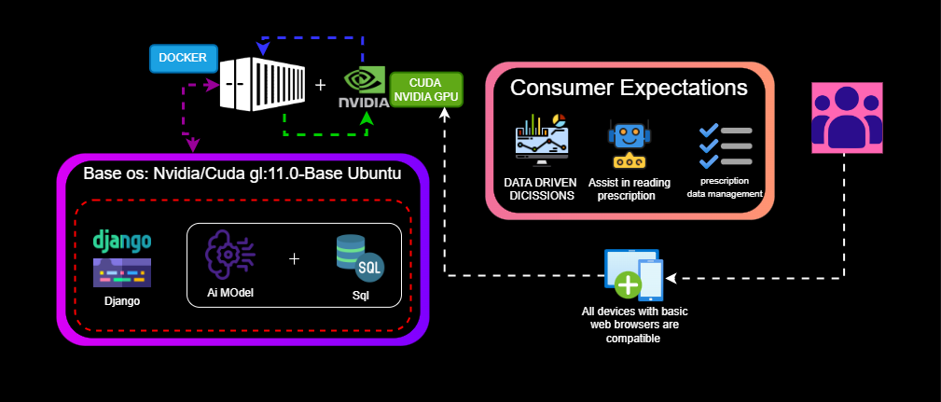
Project Architecture

Slide 6
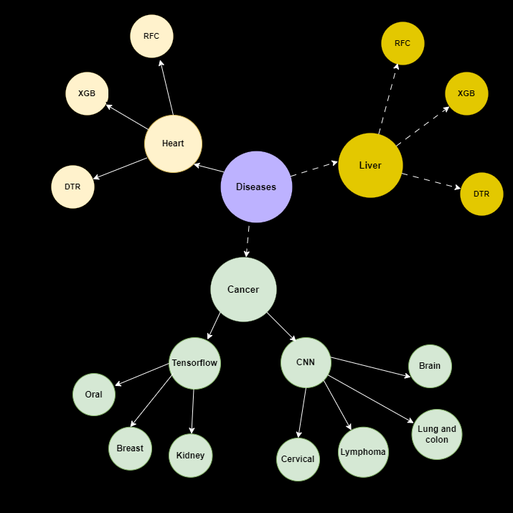
AI MODELS

Slide 7
Algorithms we are using
Decision Tree Regression (DTR):
Splits data into branches based on features.
Easy to understand but may overfit.
Random Forest (RFC):
Ensemble method combining multiple decision trees.
Robust and less prone to overfitting.
Extreme Gradient Boosting (XGB):
Boosting algorithm that optimizes the residuals of previous models.
Fast and highly accurate.
Convolutional Neural Networks (CNN):
Deep learning models for structured grid-like data (e.g., images or sequences).
Automatically learns features, useful for image-based or sequential data.
TensorFlow:
Deep learning framework for building and training neural network models.
Offers scalability and supports distributed computing.

Slide 8
About data
Sample
space
Total
Space
Included
Files
5000 images per 8 types of cancer 30000 for liver and 700 for heart
The data occupies 10 GB of disk space
The data comes with and JPG and CSV image files
JPG
CSV
Images
Our all data in jpg format, Widely used image format for compression, recognizable by the ".jpg" extension, balancing quality and file size for digital photos.
This file contains details about 14 features of the structure of the table
The images are in jpg format with an average pixel dimension of 512 x 512 PX

Slide 9
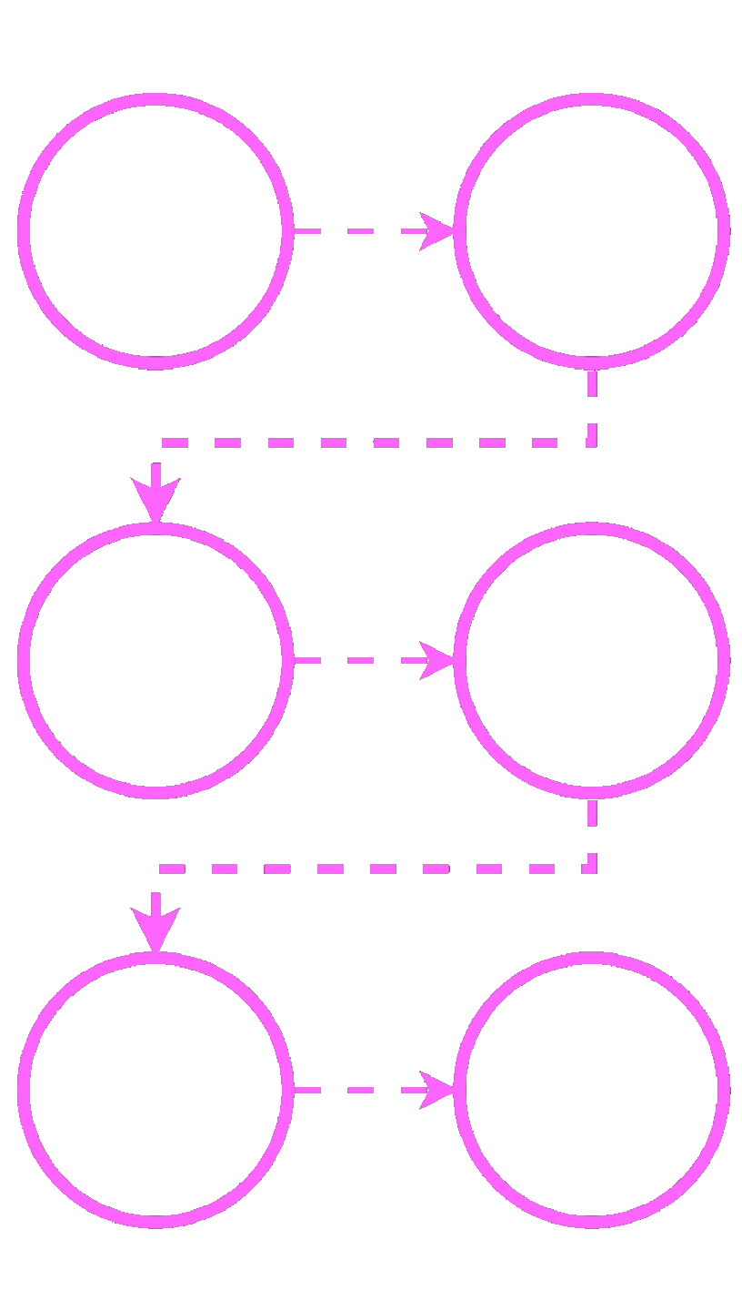
Roadmap for the project
In this slide we are describing all the steps of the project, we are doing in 6 phase :-
Development of container
Developing the virtual space with the help of the container
Server setup
Server setup involves configuring hardware and software for data storage, enable efficient operations.
1
2
Frontend page
Making of fronted page for the easy access for the consumer.
Setup backend
Setting the backend related things like API connecting database and server.
3
4
Ai model training
Training the ai model for the best accuracy and giving the best and
optimal result
Integrating everything at backend
Integrating all the things backend and server and ai model to complete the project
5
6

Slide 10
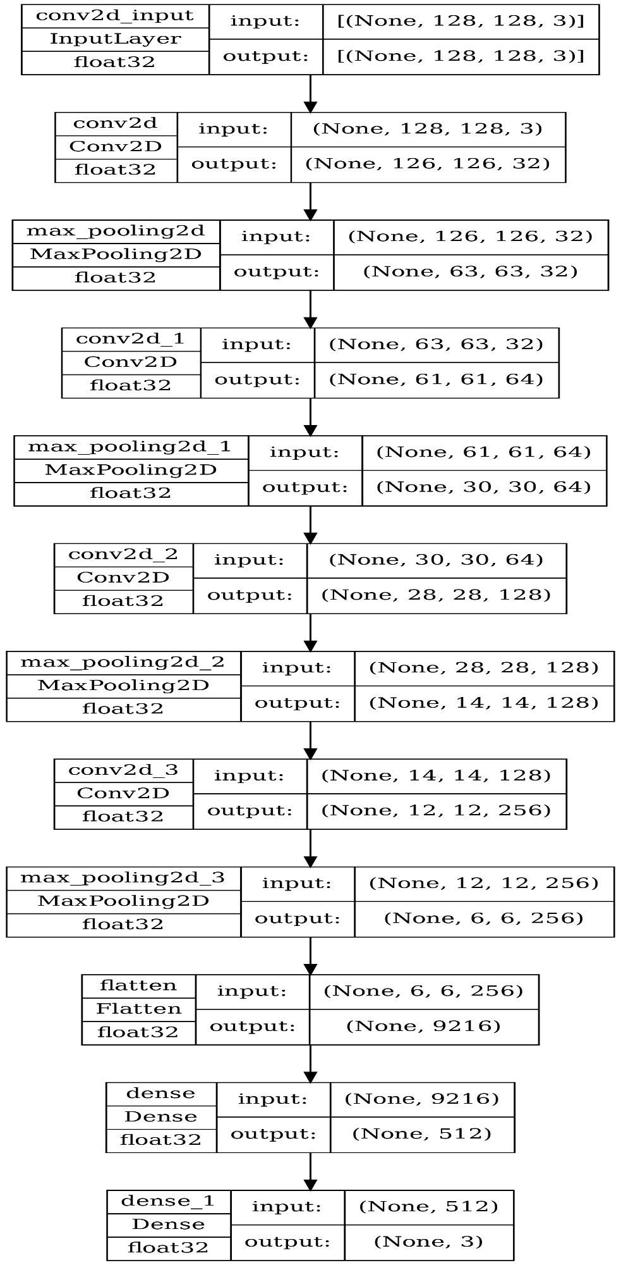
Model Architecture

Slide 11
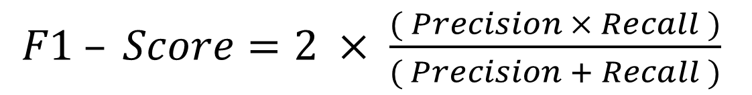
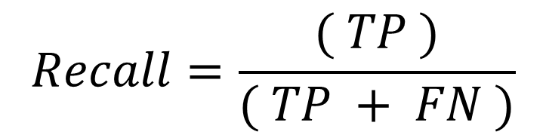
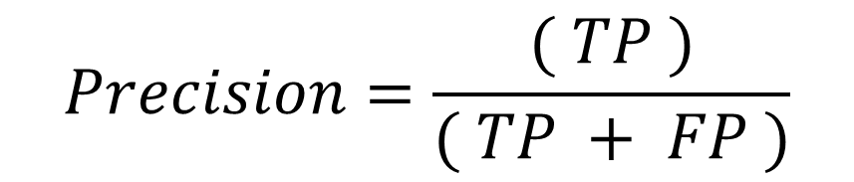
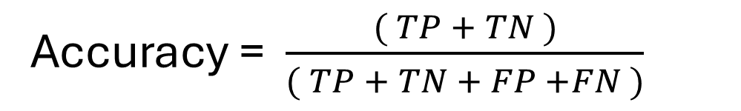
Evaluating performance measure
Accuracy = $\frac{( TP + TN )}{( TP + TN + FP +FN )}$
Equation 1
$$Precision=\frac{( TP )}{( TP + FP )}$$
Equation 2
$F1 – Score=2 × \frac{( Precision × Recall )}{( Precision + Recall )}$
Equation 3
$$Recall=\frac{( TP )}{( TP + FN )}$$
Equation 4

Slide 12
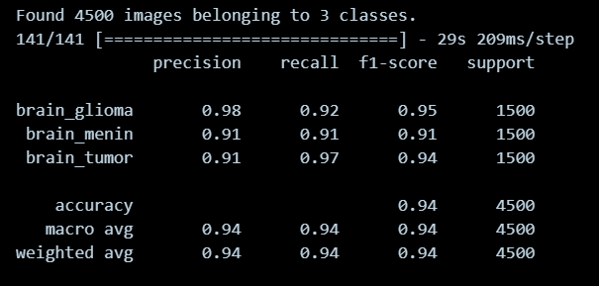
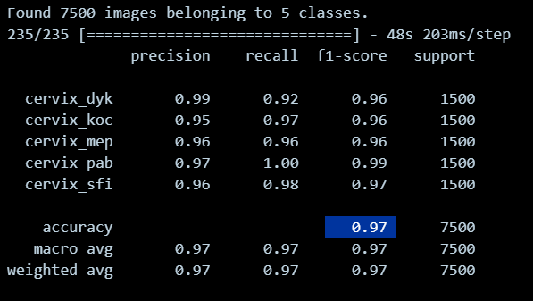
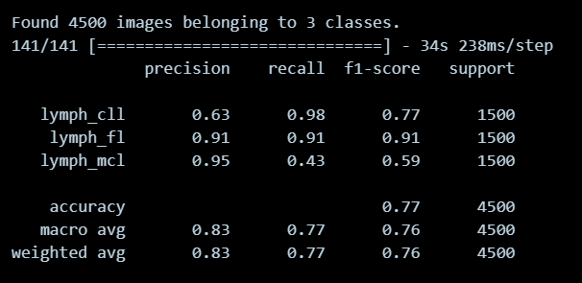
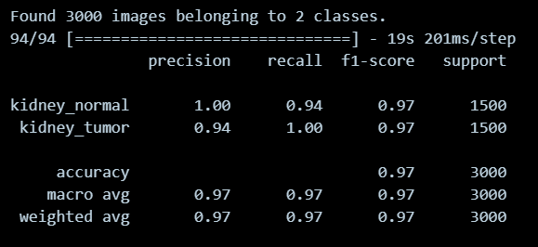
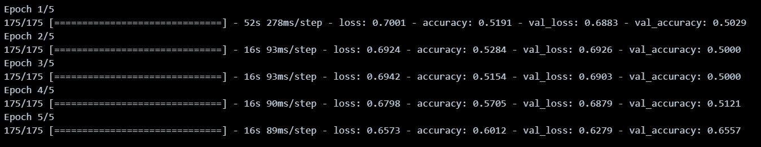
OUR Result

Slide 13
METRICS
8 Cancer
Different type of diseases we intend to predict
About 10GB
Making the whole project in efficient memory space
97% / 9%
Basic sample model accuracy/loss percentage after and further trying to improve

Slide 14
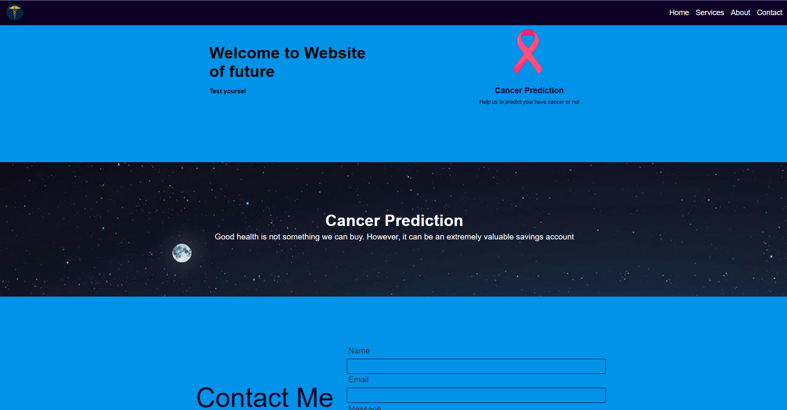
Front page

Slide 15
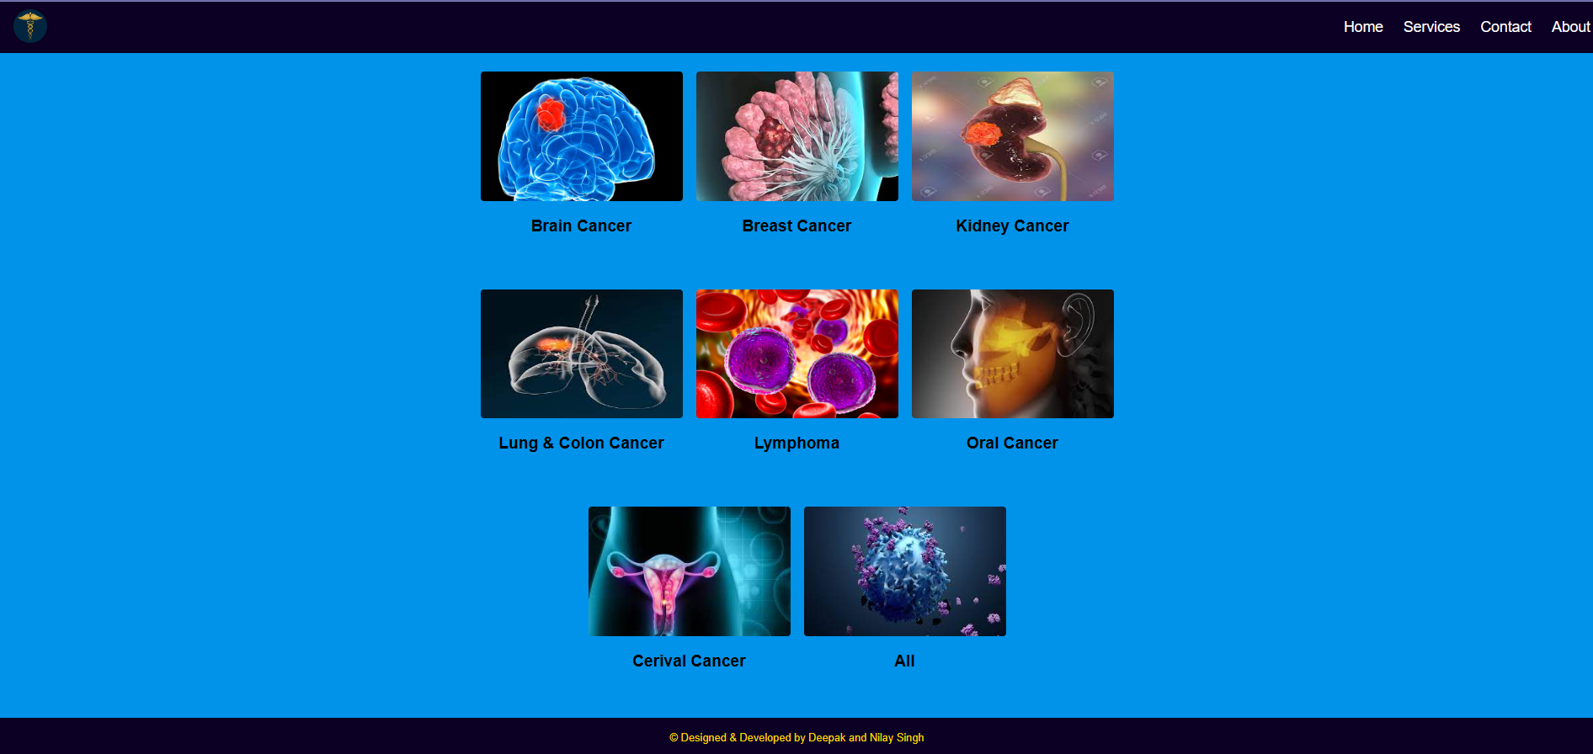
Menu page

Slide 16
Roadmap for the project
In this slide we are describing all the steps of the project, we are doing in 6 phase :-
Development of container
Developing the virtual space with the help of the container
Server setup
Server setup involves configuring hardware and software for data storage, enable efficient operations.
1
2
Frontend page
Making of fronted page for the easy access for the consumer.
Setup backend
Setting the backend related things like API connecting database and server.
3
4
Ai model training
Training the ai model for the best accuracy and giving the best and
optimal result
Integrating everything at backend
Integrating all the things backend and server and ai model to complete the project
5
6

Slide 17



Current state of project
Data pre-processing pipeline
Client-side Application
Main server
The main server is ready and already deployed under container 1
Its ready and fully functional deployable and scalable
Deployed within container 2 data pre-processing pipeline is in ready state

Slide 18





Project Timeline
INITIATION
PLANNING
EXECUTION
OPTIMIZATION
CLOSURE
Feasibility and market demand were assessed, leading to the conclusion and finalization of the development process.
Detailed project plans were created, including the development of flowcharts and design strategies.
Project tasks are performed, and the project plan is put into action.
Analysis of AI models for best efficient models so that it becomes deployable
Application
Documenting deliverables, conducting reviews, and transition outcomes.
2023
2023
2023
2023
2023
20th Feb
1st March
30th Mar
20th Apr
1st May

Slide 19
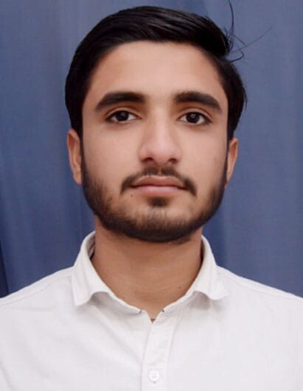
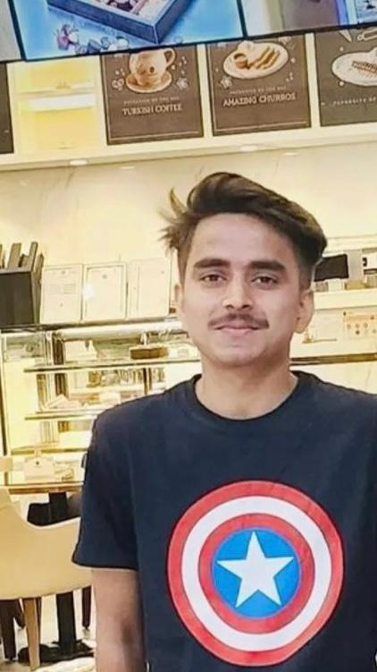
Team overview and contributions
Deepak
Nilay Singh
Python
Django
Artificial Intelligence
Frontend

